Slide 1
Week 2 Amazon Web Services Introduction
Dr Zhi Zhang

Slide 2
Overview
Brief introduction to virtualization
AWS introduction

Slide 3

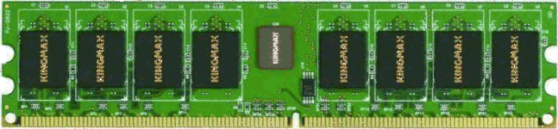





Virtualization: the core technique of cloud computing
Bob
Charlie
Alice
Physical machine
Daniel
Suppose Alice has a machine with 16 CPUs and 64 GB of memory. There are three customers:
Bob wants a machine with 8 CPUs and 32 GB of memory
Charlie wants a machine with 8 CPUs and 32 GB of memory
Daniel wants a machine with 4 CPUs and 8 GB of memory
What should Alice do?

Slide 4


Virtualization: the core technique of cloud computing
Bob
Virtual machine monitor
Charlie
Alice
Physical machine
Virtual machines
Daniel
Alice installs a virtual machine monitor (VMM) and provides each customer a guest OS/virtual machine (VM) with the requested resources
Bob is assigned with 8 vCPU and 32 GB of guest physical memory
Charlie is assigned with 8 vCPUs and 32 GB of guest physical memory
Daniel is assigned with 4 CPUs and 8 GB of guest physical memory
From each customer's perspective, it appears as if they owned the physical machine all by themselves (indicating VM isolation)
Obviously, more resources are provided by virtualization.

Slide 5
Time sharing
Bob
Virtual machine monitor
Charlie
Alice
Physical machine
Virtual machines
Daniel
VMs time-share existing hardware resources
(a time-multiplexed manner)
What if Alice serves more customers?

Slide 6
VM live migration
Bob
Virtual machine monitor
Alice
Charlie
Virtual machines
Daniel
Physical machines
What if the machine needs to be shut down for maintenance?
Alice can migrate the running VMs to different physical machines without interrupting any customers.

Slide 7
VM isolation
Bob
Virtual machine monitor
Charlie
Alice
Physical machine
Virtual machines
Daniel
One customer cannot access data of another customer

Slide 8
The benefits of virtualization
Flexible to cloud providers, who
can generate VMs with different resource capabilities
can migrate VMs if necessary (e.g., for maintenance)
can increase load by overcommitting resources
Secure to VMs
One VM cannot access another without permission
Convenient to customers
Complete control over the virtual 'hardware' (can install their own operating systems, applications, ...)
But there might be performance impacts
Load changes in one VM may affect the performance of another VM on the same physical machine

Slide 9
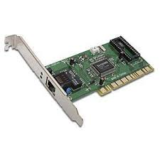
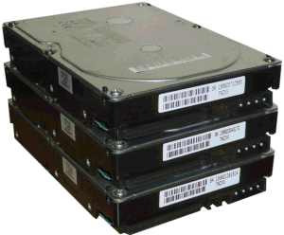
How is virtualization implemented?
VM 1
VM 2
VM | Mem_Idx in VM | Mem_Idx in VMM
1 | 0-99 | 0-99
1 | 300-399 | 100-199
2 | 0-99 | 300-399
2 | 200-299 | 500-599
2 | 600-699 | 400-499
App
App
App
OS 1
OS 2
VMM
Translation table
Physical machine
Resources (CPU, memory, and I/O devices) are virtualized
VMM ("Hypervisor") has translation tables that map virtual resources to physical resources
Example: VM 1 accesses memory cell #300; VMM maps this to memory cell #100.

Slide 10
Amazon: the pioneer
Jul 2002: Amazon Web Services launched
Mar 2006: Amazon S3 (Simple Storage Service) launched
Proposed the ‘pay-per-use’ business model, which is now the standard in cloud computing
Aug 2006: Amazon EC2 (Elastic Compute Cloud) launched
Nov 2009: Microsoft Azure Beta launched
Microsoft’s online services are gradually transitioning to Azure
Dec 2013: Google Compute Engine launched

Slide 11
What services does a cloud provide?
Three common types of cloud services:
Software as a service (SaaS)
Analogy: Restaurant. Prepares & Serves an entire meal...
Platform as a service (PaaS)
Analogy: Take-out food. Prepares meal, but does not serve it.

Slide 12
What services does a cloud provide?
Three common types of cloud services:
Software as a service (SaaS)
Analogy: Restaurant. Prepares & Serves an entire meal...
Platform as a service (PaaS)
Analogy: Take-out food. Prepares meal, but does not serve it.
Infrastructure as a service (IaaS)
Analogy: Grocery store. Provides raw ingredients.
Other xaaS (anything as a service) types have been defined, but are less common
Desktop, Backend,, Network, Monitoring, ...

Slide 13

Software as a Service (SaaS)
SaaS provider
Application
Middleware
Hardware
Cloud provides an entire application
Email, Drive, Doc, Slides,...
Example: Google Workspace

Slide 14
Platform as a Service (PaaS)
PaaS provider
Application
Middleware
Hardware
Cloud provides middleware
Common Language Runtime environment
Example: Heroku

Slide 15
Infrastructure as a Service (IaaS)
IaaS provider
Application
Middleware
Hardware
Cloud provides hardware resources
Virtual Machines, Virtual Memory, Virtual Disk,...
Examples: AWS (Amazon Web Services)

Slide 16

Public/community/Private clouds
Company A
Company B
Public
Community
Private
Targeting different customers:
Public cloud: open to general public.
Example: AWS, Microsoft Azure, Google Compute Engine
Community cloud: shared by multiple organizations with common interests and requirements.
Example: Healthcare Sectors
Private cloud: exclusively used by a single organization.
Example: Google’s internal datacenter

Slide 17
Practice Questions
[7 marks] Q1: What is service (XaaS) cloud computing? Describe the different categories of XaaS cloud computing can provide with specific examples of each service.

Slide 18
Practice Questions
[7 marks] Q1: What is service (XaaS) cloud computing? Describe the different categories of XaaS cloud computing can provide with specific examples of each service.
[1 mark] Cloud computing offers a range of services, referred to as "XaaS," which stands for "Anything as a Service."
[2 marks] Infrastructure as a Service that provides virtualized computing resources. An example is AWS.
[2 marks] Platform as a Service that provides a runtime environment for developers to build, deploy, and manage applications. An examples is Google App Engine or Heroku.
[2 marks] Software as a Service that delivers fully functional software applications. An example is Microsoft 365 office or Google workplace.

Slide 19
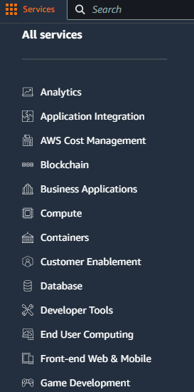
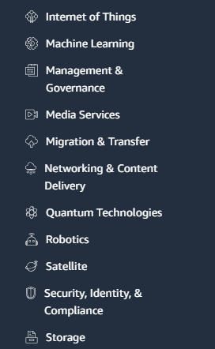
AWS: the leading cloud providing a wide range of services

Slide 20
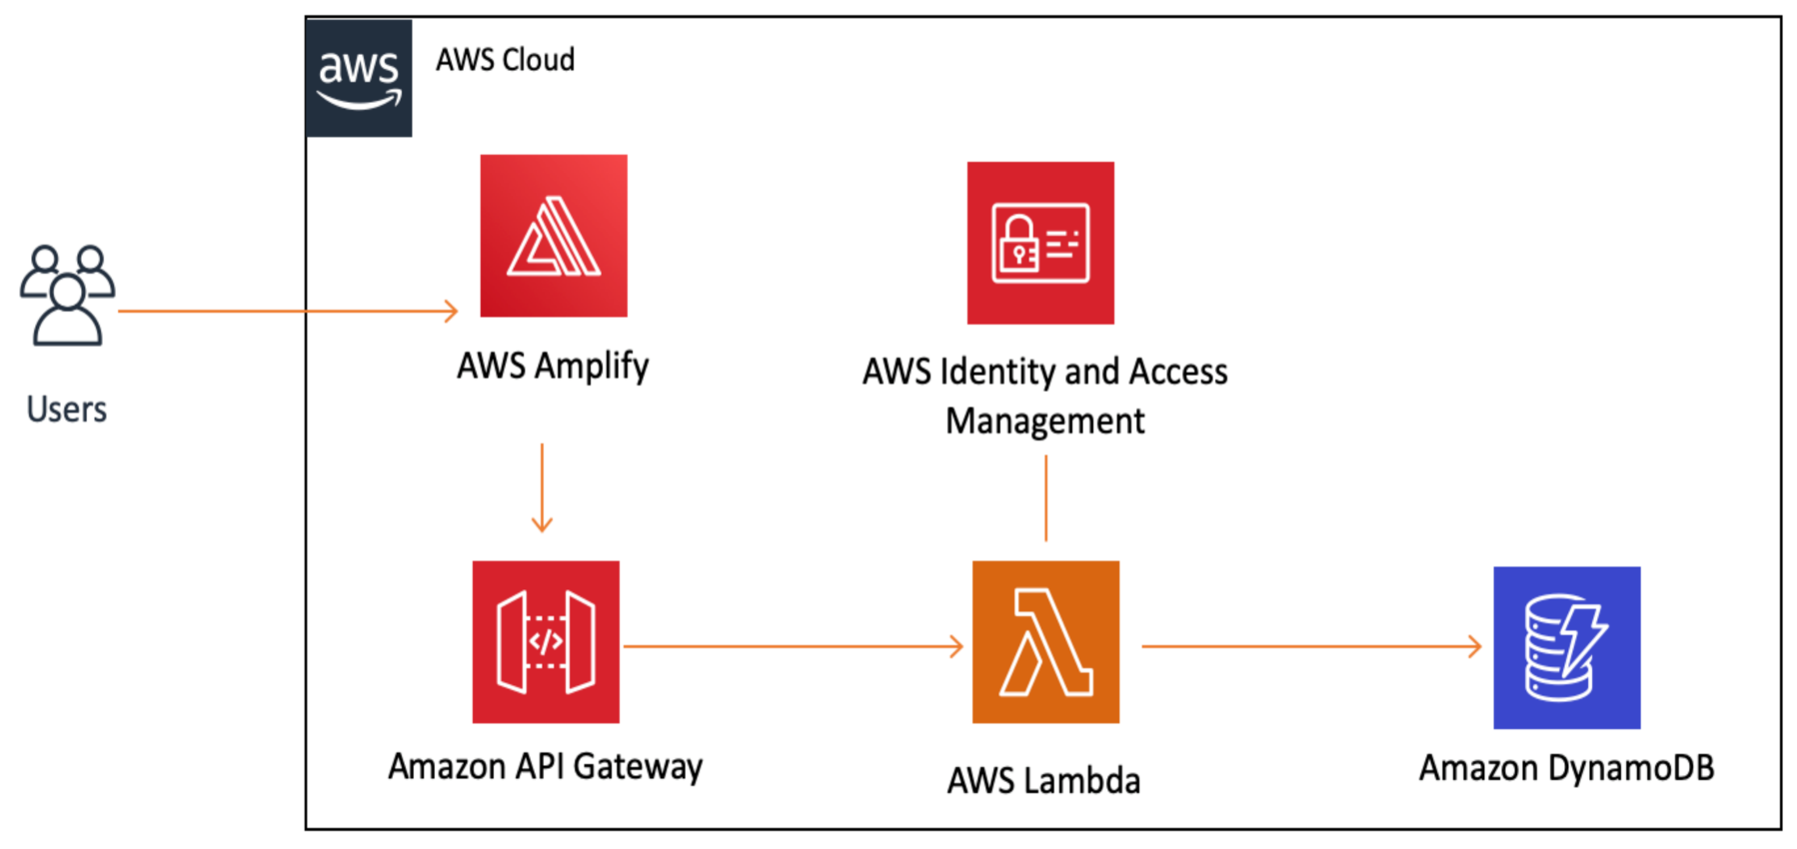
AWS: the leading cloud providing a wide range of services
The services satisfy different needs of customers:
Allowing us to design, deploy, and manage applications on the cloud, so-called application architecture.
e.g., build a web application

Slide 21
What is an application architecture?
It is the structural design and organization of a software application.
Main types of application architectures
Monolithic architecture: combines the frontend, backend, and database functionalities into a single application.
e.g., ?

Slide 22
What is an application architecture?
It is the structural design and organization of a software application.
Main types of application architectures
Monolithic architecture: combines the frontend, backend, and database functionalities into a single application.
e.g., wordpress: a content management system (CMS)

Slide 23
What is an application architecture?
It is the structural design and organization of a software application.
Main types of application architectures
Monolithic architecture: combines the frontend, backend, and database functionalities into a single application.
e.g., wordpress: a content management system (CMS)
Client/Server architecture: an application is split into two main components: the client, which handles the user requests, and the server, which handles the processing of requests and data storage.
e.g., ?

Slide 24
What is an application architecture?
It is the structural design and organization of a software application.
Main types of application architectures
Monolithic architecture: combines the frontend, backend, and database functionalities into a single application.
e.g., wordpress: a content management system (CMS)
Client/Server architecture: an application is split into two main components: the client, which handles the user requests, and the server, which handles the processing of requests and data storage.
e.g., gmail

Slide 25
What is an application architecture?
It is the structural design and organization of a software application.
Main types of application architectures
Monolithic architecture: combines the frontend, backend, and database functionalities into a single application.
e.g., wordpress: a content management system (CMS)
Client/Server architecture: an application is split into two main components: the client, which handles the user requests, and the server, which handles the processing of requests and data storage.
e.g., gmail
Three-tier architecture: a presentation tier (frontend), application logic tier (backend), and a database tier (backend).
e.g., ?

Slide 26
What is an application architecture?
It is the structural design and organization of a software application.
Main types of application architectures
Monolithic architecture: combines the frontend, backend, and database functionalities into a single application.
e.g., wordpress: a content management system (CMS)
Client/Server architecture: an application is split into two main components: the client, which handles the user requests, and the server, which handles the processing of requests and data storage.
e.g., gmail
Three-tier architecture: a presentation tier (frontend), application logic tier (backend), and a database tier (backend).
e.g., Shopify: an e-commerce platform.

Slide 27
What is an application architecture?
It is the structural design and organization of a software application.
Main types of application architectures
Monolithic architecture: combines the frontend, backend, and database functionalities into a single application.
e.g., wordpress: a content management system (CMS)
Client/Server architecture: an application is split into two main components: the client, which handles the user requests, and the server, which handles the processing of requests and data storage.
e.g., gmail
Three-tier architecture: a presentation tier (frontend), application logic tier (backend), and a database tier (backend).
e.g., Shopify: an e-commerce platform.
Cloud-based serverless architecture: known as Function-as-a-Service, which is a cloud computing model where the cloud provider provisions, maintain and scale applications.
e.g., ?

Slide 28
What is an application architecture?
It is the structural design and organization of a software application.
Main types of application architectures
Monolithic architecture: combines the frontend, backend, and database functionalities into a single application.
e.g., wordpress: a content management system (CMS)
Client/Server architecture: an application is split into two main components: the client, which handles the user requests, and the server, which handles the processing of requests and data storage.
e.g., gmail
Three-tier architecture: a presentation tier (frontend), application logic tier (backend), and a database tier (backend).
e.g., Shopify: an e-commerce platform.
Cloud-based serverless architecture: known as Function-as-a-Service, which is a cloud computing model where the cloud provider provisions, maintain and scale applications.
e.g., AWS Lambda

Slide 29
Deploying application architecture
When an architecture is ready, it can be deployed onto AWS via different services:
Elastic Compute Cloud (EC2): an EC2 instance is a virtual machine that runs a Windows or Linux server. It is essentially running on Virtual Machine Monitor (VMM).
Elastic Container Service (ECS): a customized environment provided by an EC2 instance.

Slide 30
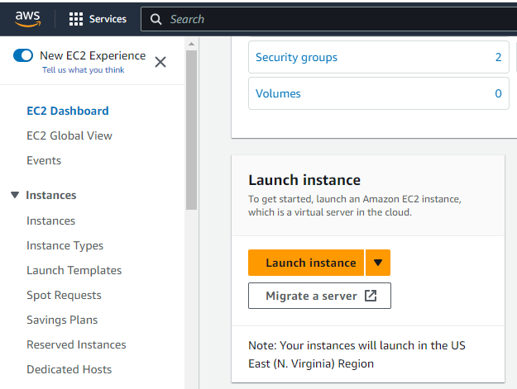
AWS EC2
Steps of creating, configuring and launching an EC2 instance :
Sign in to the AWS Management Console:
https://aws.amazon.com/ or https://489389878001.signin.aws.amazon.com/console
Navigate to EC2 Dashboard and Click “Launch instance”

Slide 31
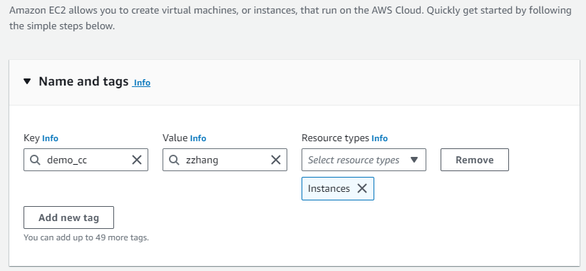
AWS EC2
Steps of creating, configuring and launching an EC2 instance :
“Name and tags”: In this step, we can add names and tags to our instance. Tags are key-value pairs that help identify and categorize instances for better management, e.g., Key: demo_cloudcompute, Value: MyEC2Instance. We can click the "Add new tag" button to add multiple tags as needed.

Slide 32
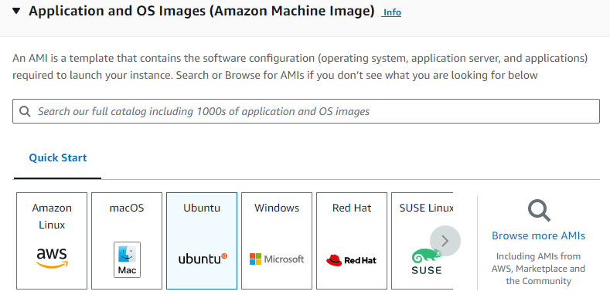
AWS EC2
Steps of creating, configuring and launching an EC2 instance :
“Application and OS Images (Amazon Machine Image)”: In this step, we select an AMI that suits our requirements. We can choose from various operating systems and pre-configured applications. The definition of an AMI is as follows:

Slide 33
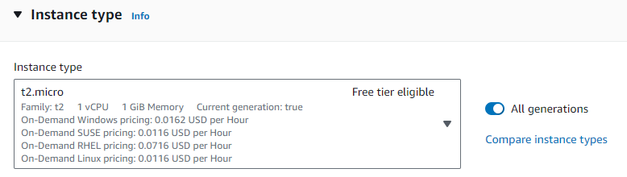
AWS EC2
Steps of creating, configuring and launching an EC2 instance :
“Instance type”: In this step, we select an appropriate instance type that meets our computing, memory, networking or storage needs.

Slide 34
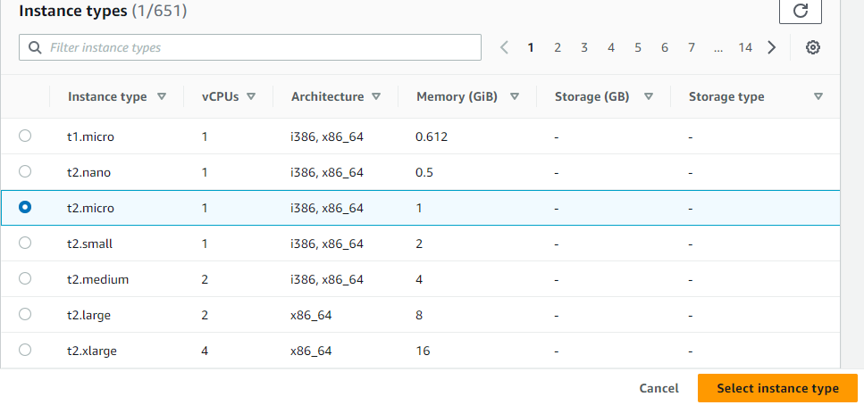
AWS EC2
Steps of creating, configuring and launching an EC2 instance :
“Instance type”
What does Architecture mean?

Slide 35
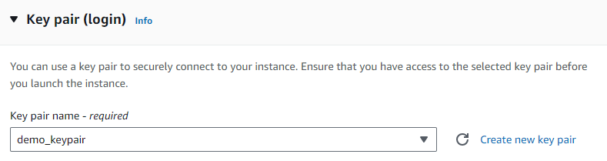
AWS EC2
Steps of creating, configuring and launching an EC2 instance :
“Key pair (login)”: In this step, we can select/create a key pair (SSH key) for secure access to our first instance. If we currently don't have a key pair, we can create one.

Slide 36
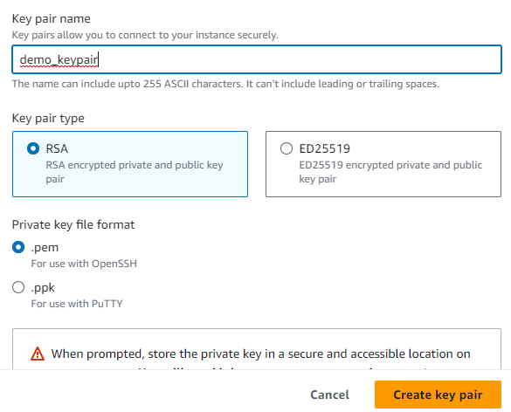
AWS EC2
Steps of creating, configuring and launching an EC2 instance :
“Key pair (login)”:

Slide 37
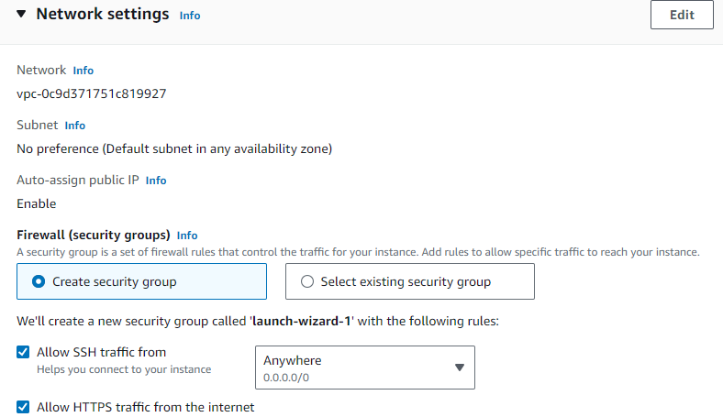
AWS EC2
Steps of creating, configuring and launching an EC2 instance :
“Network settings”: In this step, we configure the network based on the application of our instance, e.g., connect to the instance via SSH or RDP, create security group, etc.

Slide 38
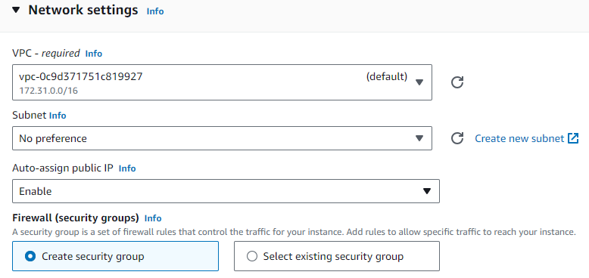
AWS EC2
Steps of creating, configuring and launching an EC2 instance :
“Network settings”

Slide 39
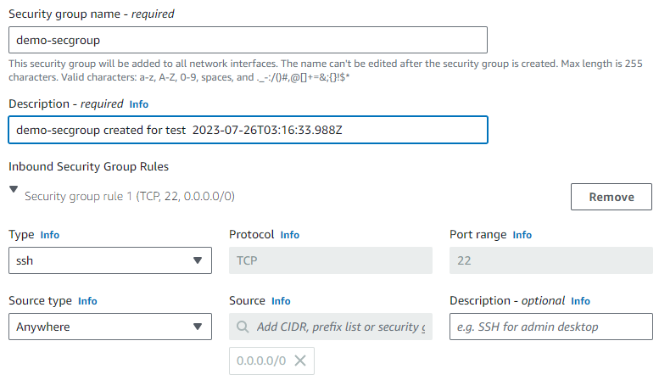
AWS EC2
Steps of creating, configuring and launching an EC2 instance :
“Network settings”
Create security group: a security group is a set of firewall rules that control the network traffic for our instance. We can add rules to allow specific traffic to reach our instance.

Slide 40
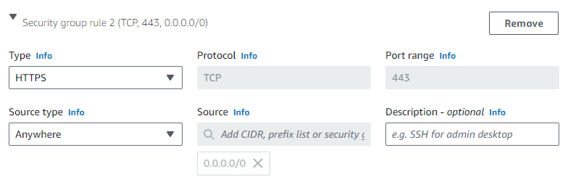
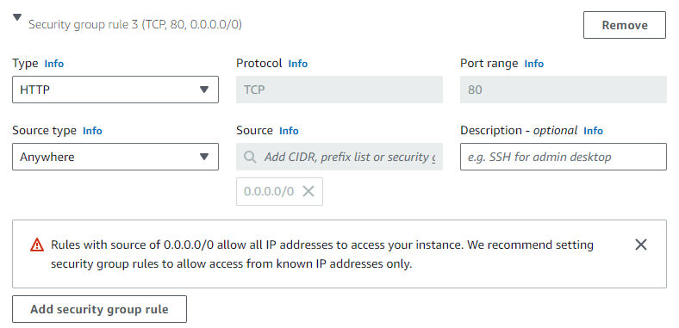
AWS EC2
Steps of creating, configuring and launching an EC2 instance :
“Network settings”
Create security group

Slide 41
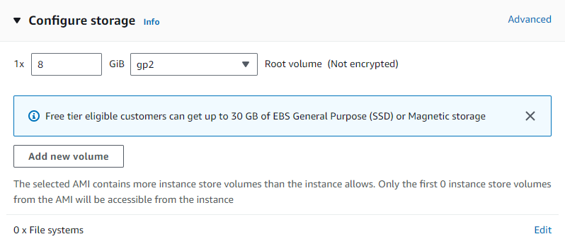
AWS EC2
Steps of creating, configuring and launching an EC2 instance :
“Configure storage”: In this step, we specify storage volume for our instance. By default, one Elastic Block Store (EBS) volume is attached to the instance. We can add more EBS volumes if needed.

Slide 42
AWS EC2
Steps of creating, configuring and launching an EC2 instance :
“Configure storage”
What is EBS about?
provides block level storage volumes for use with EC2 instances.
EBS storage is allocated in volumes. A volume is a 'virtual disk' (size from 1GB to 1TB)
Can be attached to any instance in the same Availability Zone
We pay for what we use with EBS.

Slide 43
AWS EC2
Steps of creating, configuring and launching an EC2 instance :
“Configure storage”
EBS features
Persistent Storage: EBS volumes persist independently from EC2 instances, indicating that when an instance is terminated, the data stored on the attached EBS volume CAN be retained.
High durability and availability: EBS replicates volumes data across multiple physical servers within the same availability zone to prevent the loss of data from hardware failures.
Snapshots: allows users to create point-in-time snapshots of their volumes. These snapshots serve as backups and can be used to restore volumes to a previous state.
Elastic volumes : allows users to dynamically adapt their volumes when the needs of their applications change.

Slide 44
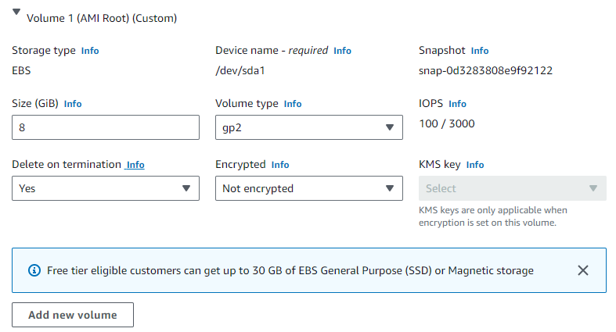
AWS EC2
Steps of creating, configuring and launching an EC2 instance :
“Configure storage”
EBS setting

Slide 45
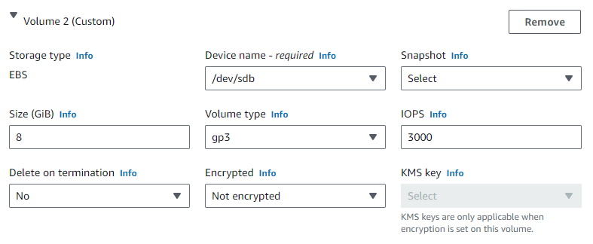
AWS EC2
Steps of creating, configuring and launching an EC2 instance :
“Configure storage”
EBS setting

Slide 46
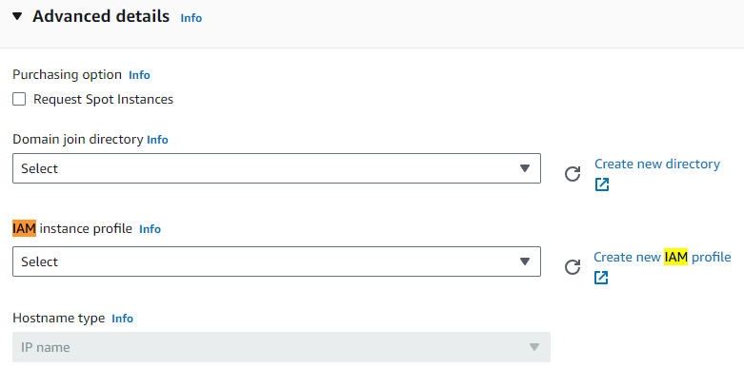
AWS EC2
Steps of creating, configuring and launching an EC2 instance :
“Advanced details”

Slide 47
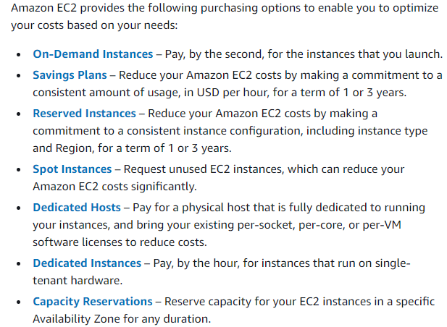
AWS EC2
Steps of creating, configuring and launching an EC2 instance :
“Advanced details”
Instance purchasing options

Slide 48
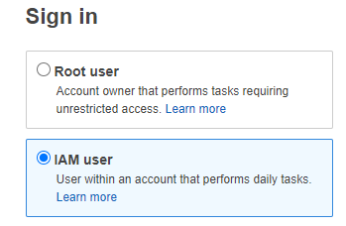
AWS EC2
Steps of creating, configuring and launching an EC2 instance :
“Advanced details”
Identity and Access Management (IAM) : It is a service that allows us to manage users, groups, and permissions to securely control access to AWS resources, e.g., root user and IAM user (according to the principle of least privilege).
What is the principle of least privilege?

Slide 49
AWS EC2
Steps of creating, configuring and launching an EC2 instance :
“Advanced details”
Identity and Access Management (IAM) : It is a service that allows us to manage users, groups, and permissions to securely control access to AWS resources, e.g., root user and IAM user (according to the principle of least privilege).
What is the principle of least privilege?
A user only has those privileges which are essentially vital to perform their intended operations. Thus, root user in AWS can be regarded as the system administer in a local OS. IAM user is a normal user in the OS.

Slide 50
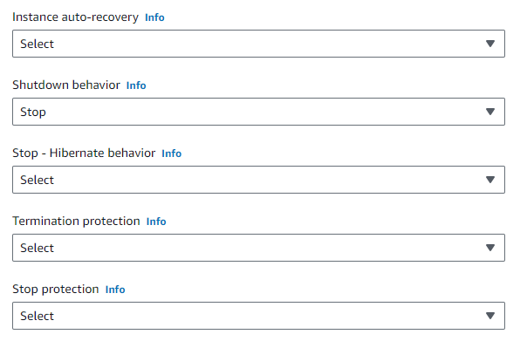
AWS EC2
Steps of creating, configuring and launching an EC2 instance :
“Advanced details”

Slide 51
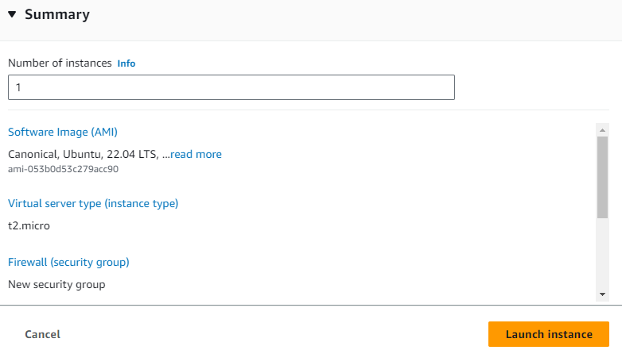
AWS EC2
Steps of creating, configuring and launching an EC2 instance :
“Review and Launch”

Slide 52
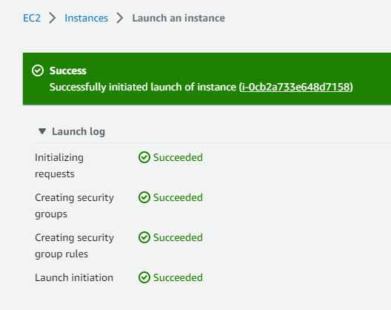
AWS EC2
Steps of creating, configuring and launching an EC2 instance :
“Review and Launch”

Slide 53
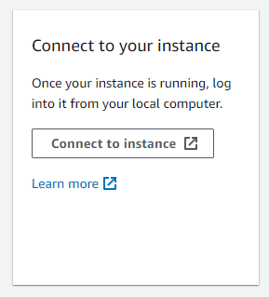
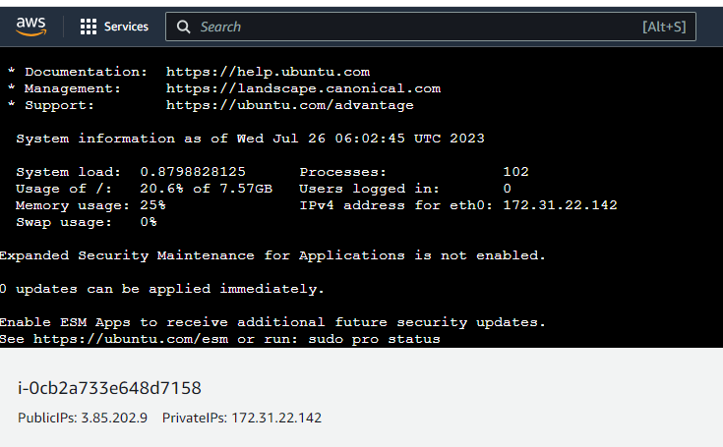
AWS EC2
Connecting to an EC2 instance :

Slide 54
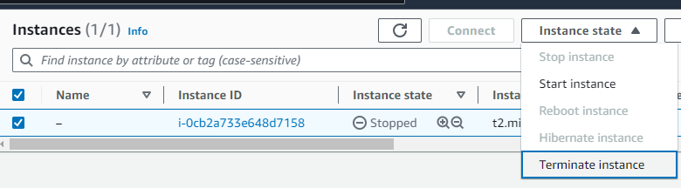
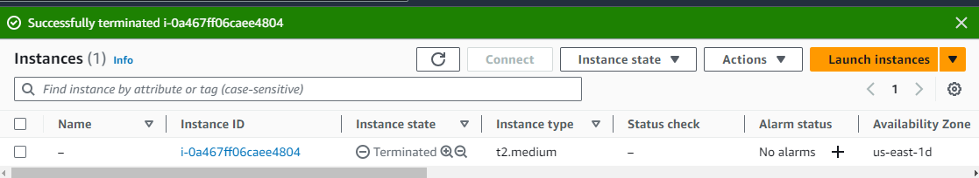
AWS EC2
Terminating an EC2 instance :

Slide 55
Demo
Create, configure and launch an instance
Connect to an instance
Terminate an instance

Slide 56
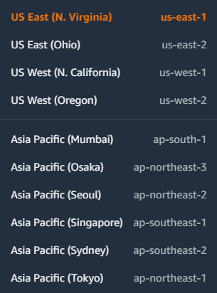
Geographical location of an instance
AWS region:
There are many different geographical locations for AWS data centers around the world, known as “AWS Regions”, identified by names such as “us-west-2” (US West-Oregon).

Slide 57
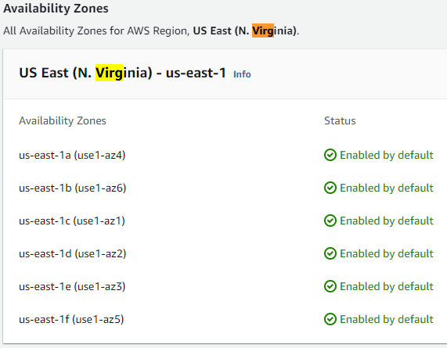
Geographical location of an instance
Availability zone:
Each region is further divided into multiple availability zones, which are identified by additional letters such as “us-west-2a” and “us-west-2b”.
Each zone represents a separate data center in different physical locations within a region.
Each zone within a region is networked with low-latency connections

Slide 58
Practice Questions
[10 marks] Q2: Describe the steps which you would take on AWS and the decisions that would need to be made to create, configure and launch an EC2 Instance.
[1 mark] Sign in to the AWS management console
[1 mark] Navigate to EC2 Dashboard and click “Launch instance”
[1 mark] Select/Create names and tags
[2 marks] Select AMI and Instance type
[1 mark] Select/Create Key pair for login
[3 marks] Configure network settings, storage and more advanced details (e.g., specify some self-defined behaviors)
[1 mark] Review and launch

Slide 59
Practice Questions
[7 marks] Q3: Describe EBS and what features it offers.
[1 mark] A brief introduction to EBS.
[2 marks] One feature and its brief description.
[2 marks] One feature and its brief description.
[2 marks] One feature and its brief description.

